Slide 1
Root anatomies and hydraulics with GRANAR-MECHA
Adrien Heymans
Valentin Couvreur
Guillaume Lobet
Marco d’agostino
Notes:
Add Q

Slide 2
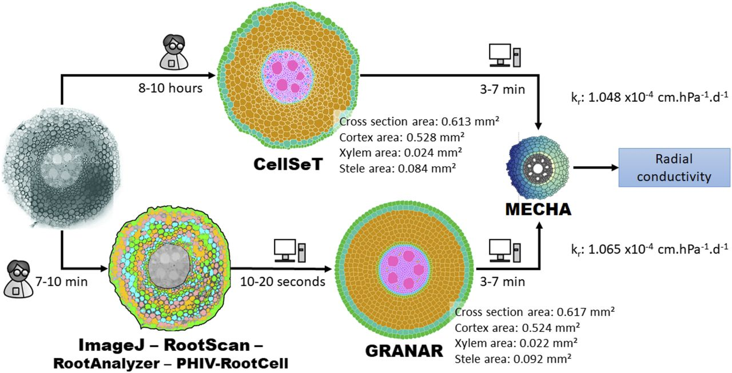
Intro
Load
Modify
Run
Visualise
Export

Slide 3
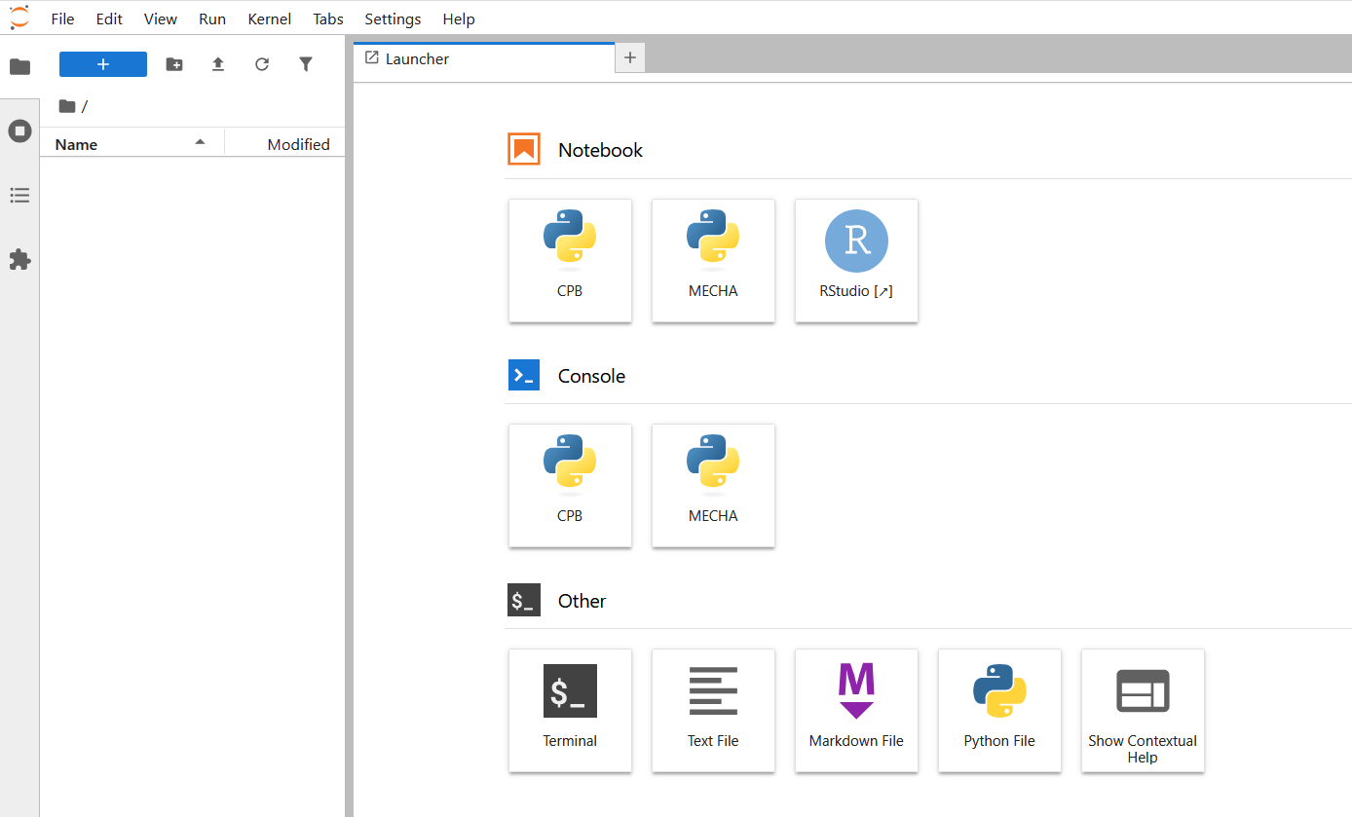
SIMULATING ROOT ANATOMIES
- GRANAR & MECHA -
- Modelling Root Hydraulic Anatomies -
3

Slide 4
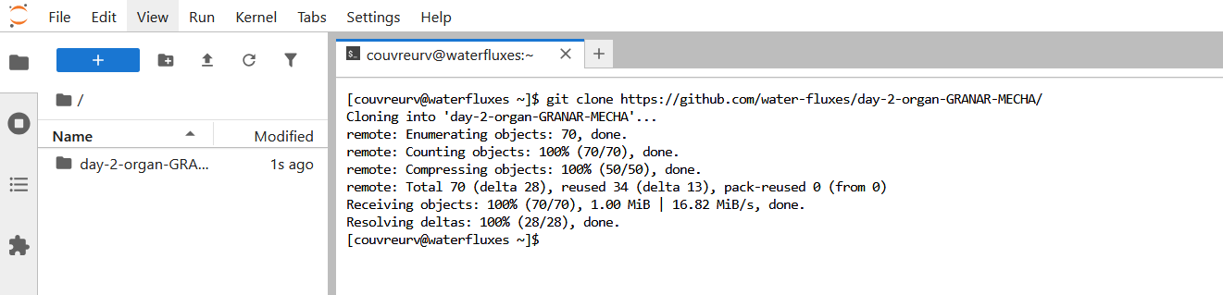
SIMULATING ROOT ANATOMIES
- GRANAR & MECHA -
git clone https://github.com/water-fluxes/day-2-organ-GRANAR-MECHA/
- Modelling Root Hydraulic Anatomies -
4

Slide 5
SIMULATING ROOT ANATOMIES
- GRANAR -
- Modelling Root Hydraulic Anatomies -
5

Slide 6
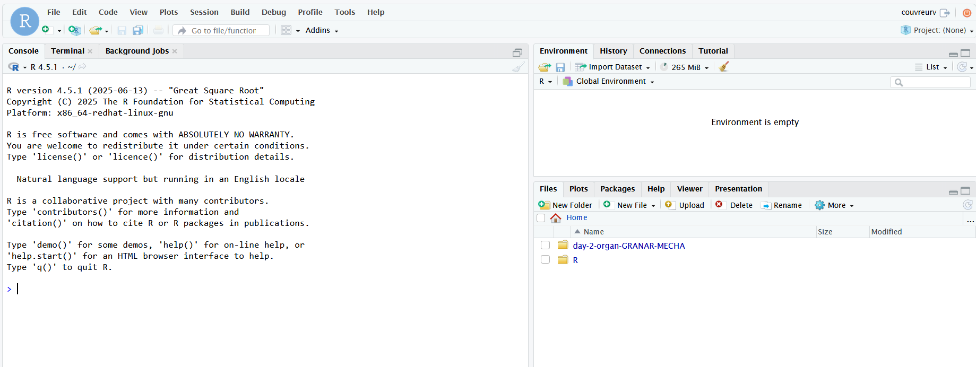
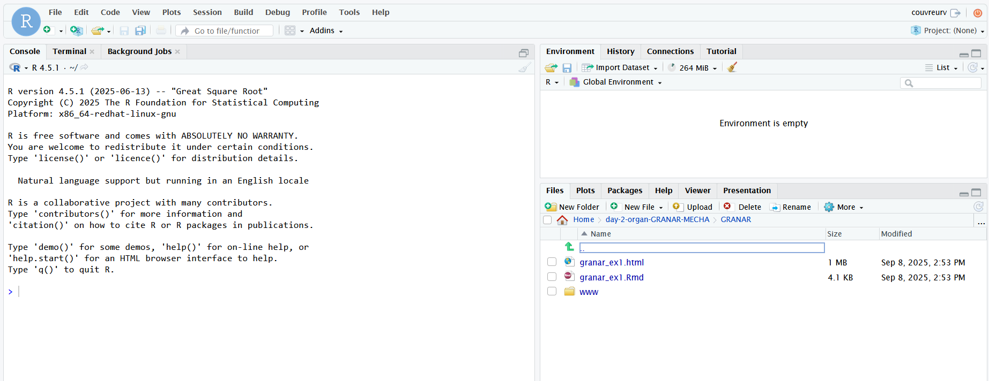
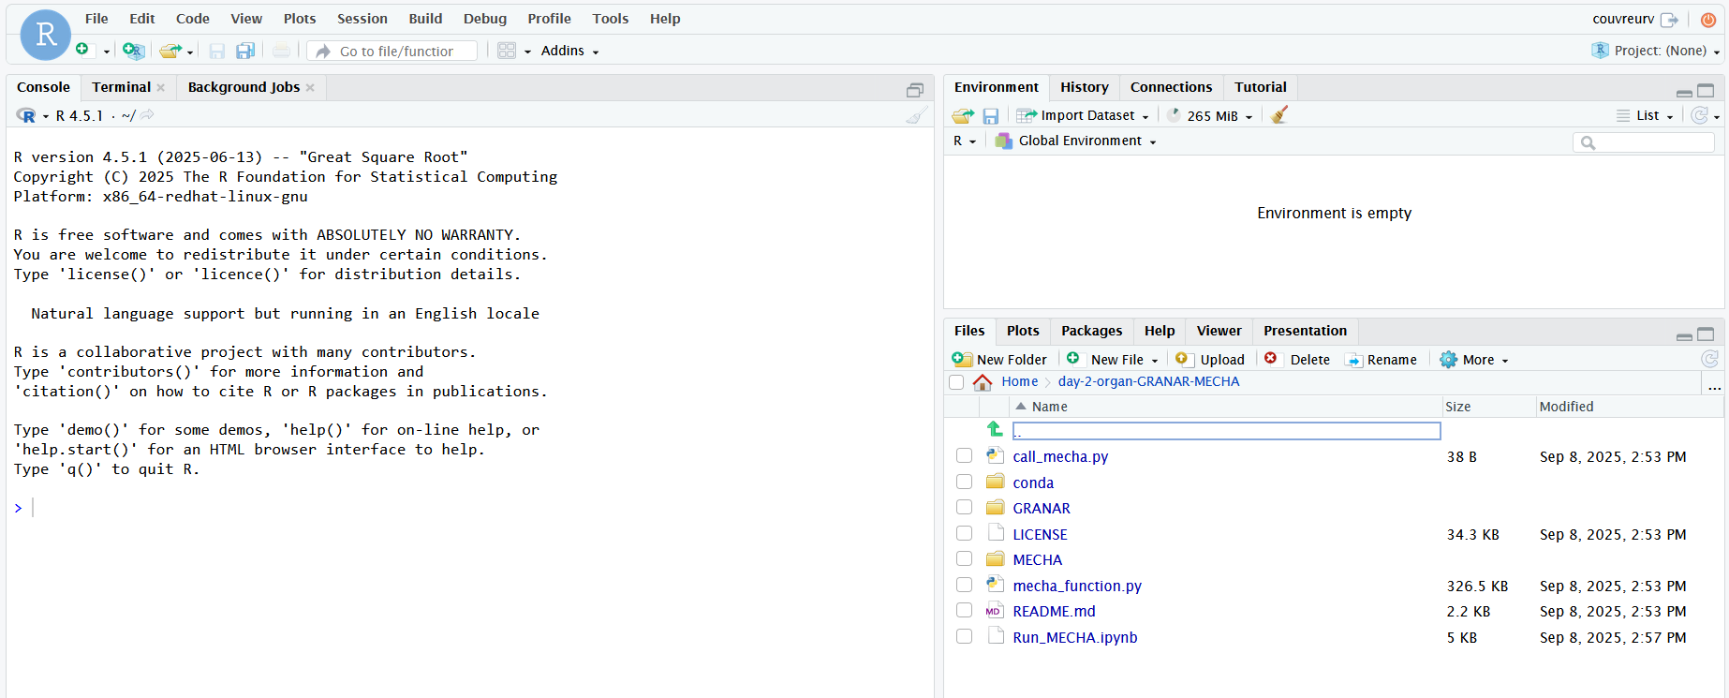
SIMULATING ROOT ANATOMIES
- GRANAR -
- Modelling Root Hydraulic Anatomies -
6

Slide 7
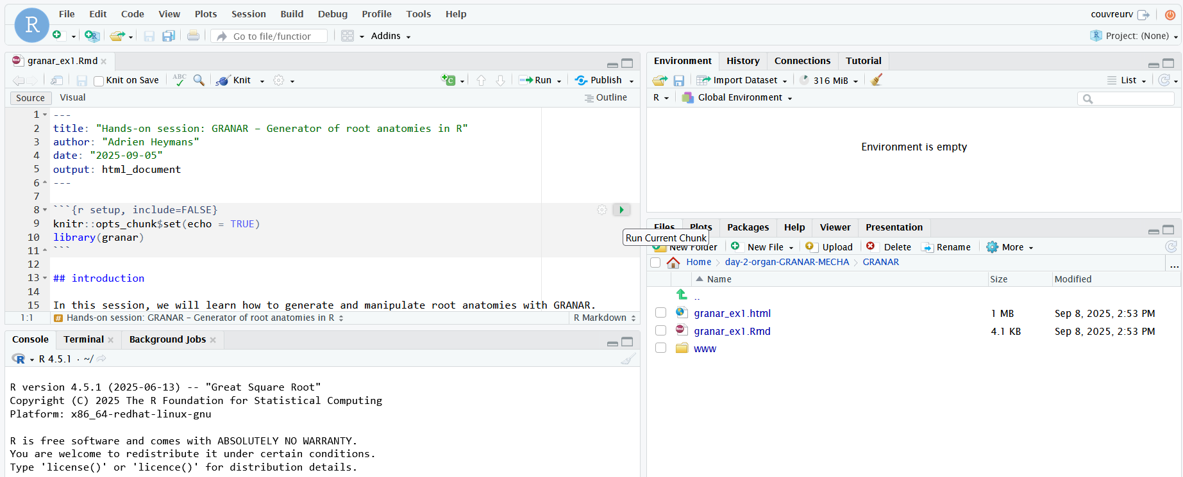
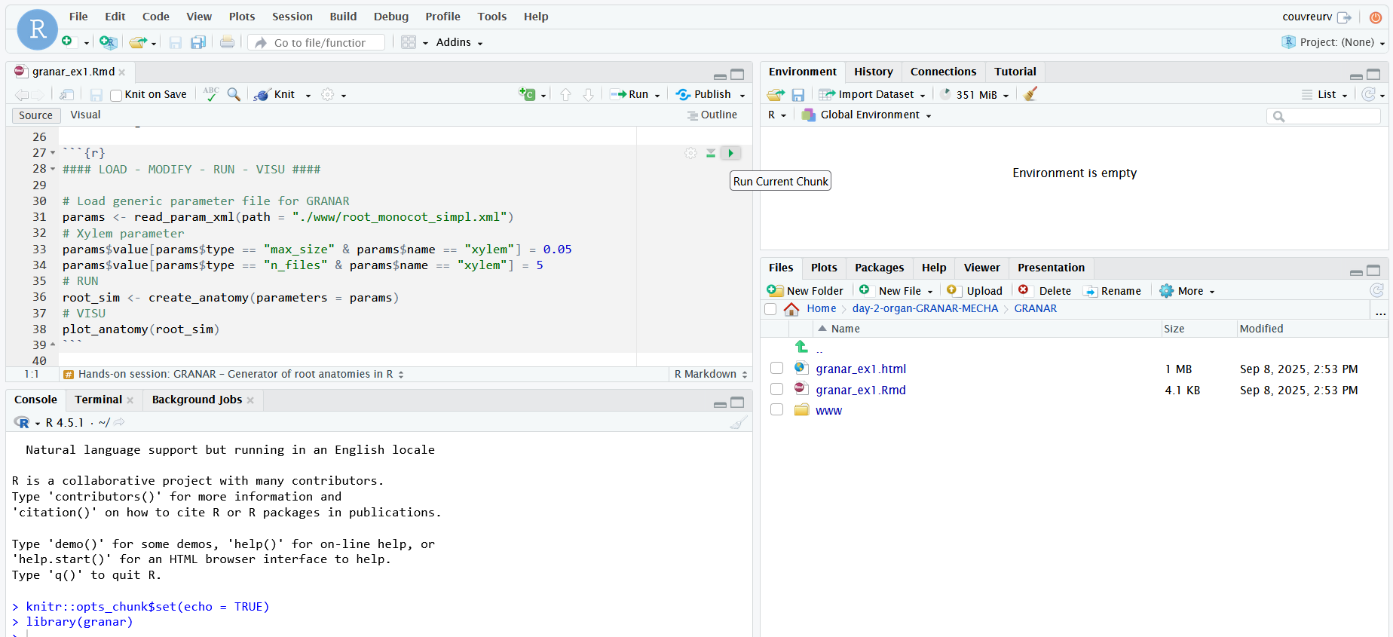
SIMULATING ROOT ANATOMIES
- GRANAR -
- Modelling Root Hydraulic Anatomies -
7

Slide 8
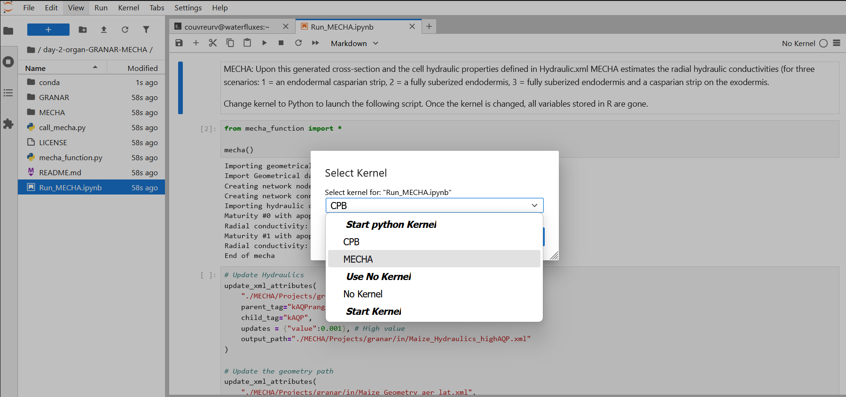
SIMULATING ROOT ANATOMIES
- GRANAR -
git clone https://github.com/water-fluxes/day-2-organ-GRANAR-MECHA/
- Modelling Root Hydraulic Anatomies -
8

Slide 9
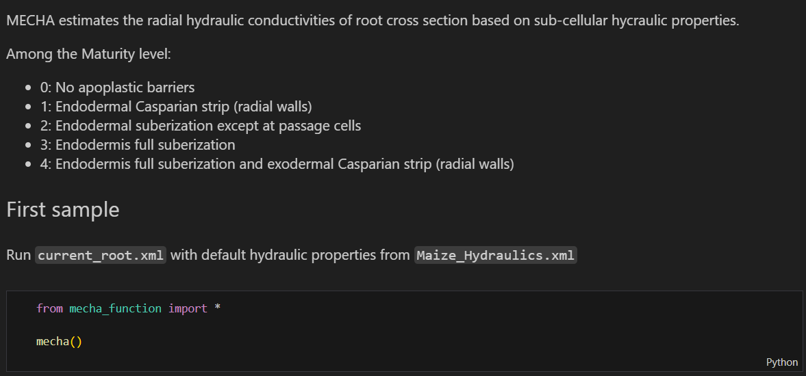
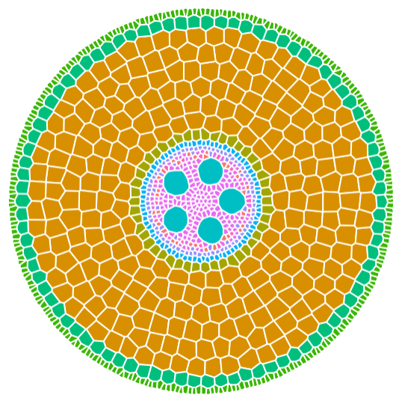
SIMULATING ROOT ANATOMIES
- MECHA -
- Modelling Root Hydraulic Anatomies -
9

Slide 10
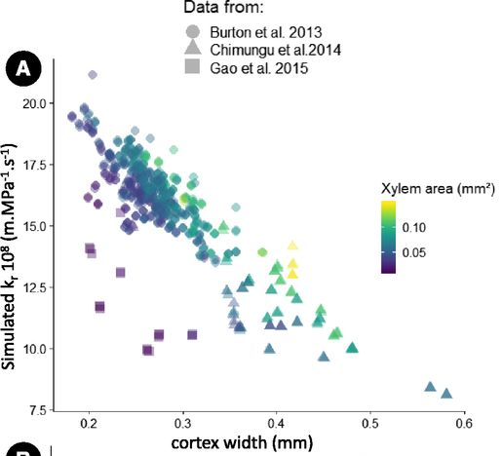
SENSITIVITY ANALYSIS
- Modelling Root Hydraulic Anatomies -
10

Slide 11
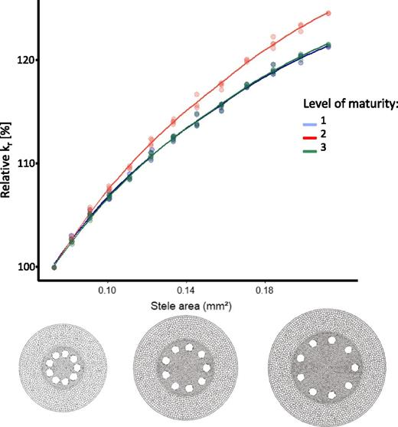
SENSITIVITY ANALYSIS
- Modelling Root Hydraulic Anatomies -
11

Slide 12
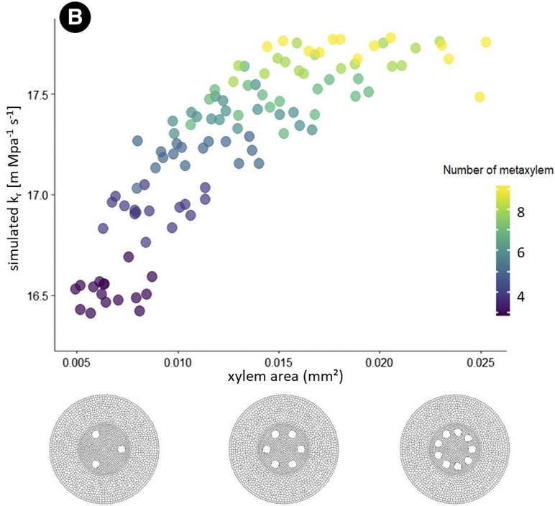
SENSITIVITY ANALYSIS
- Modelling Root Hydraulic Anatomies -
12

Slide 13
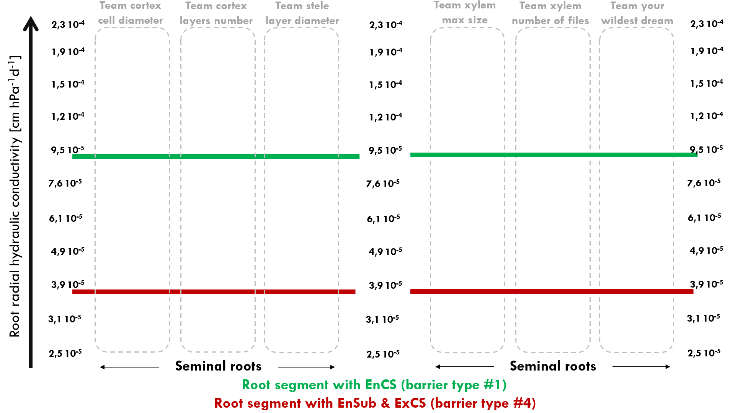

Slide 14
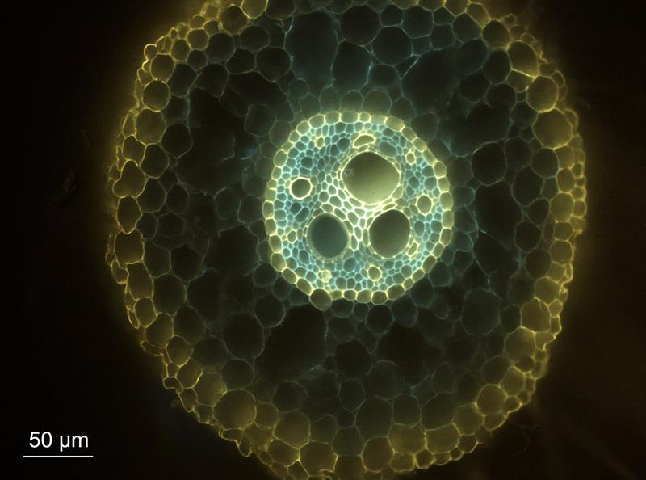
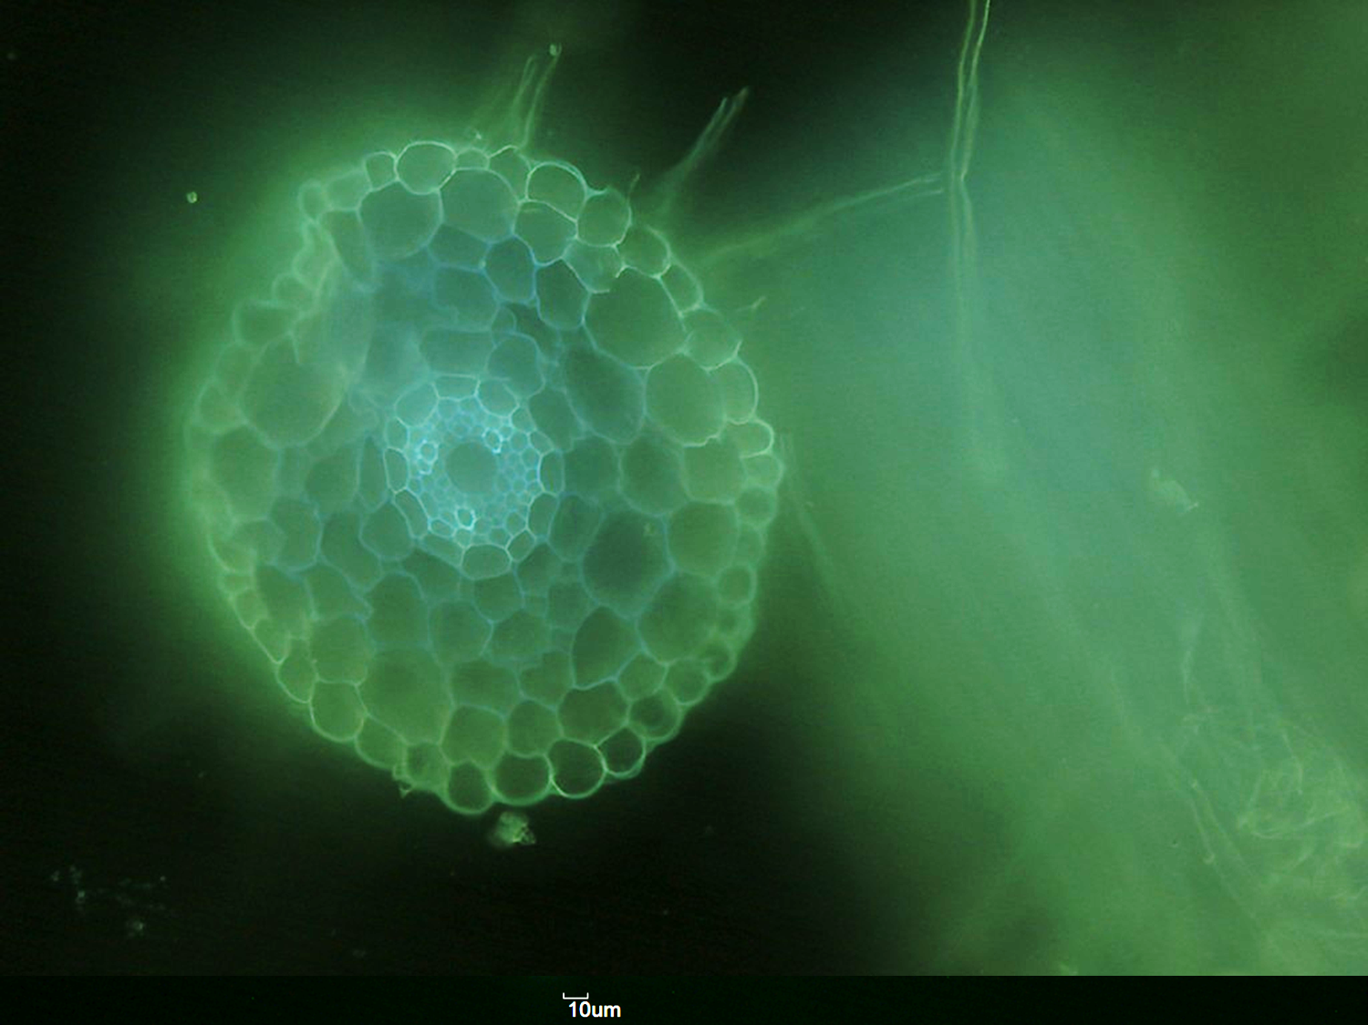
HANDS ON GRANAR
Try to reproduce one of these anatomies
Principal root maize B73
Lateral root maize B73
- Modelling Root Hydraulic Anatomies -
14

Slide 16
- Modelling Root Hydraulic Anatomies -
16

Slide 17
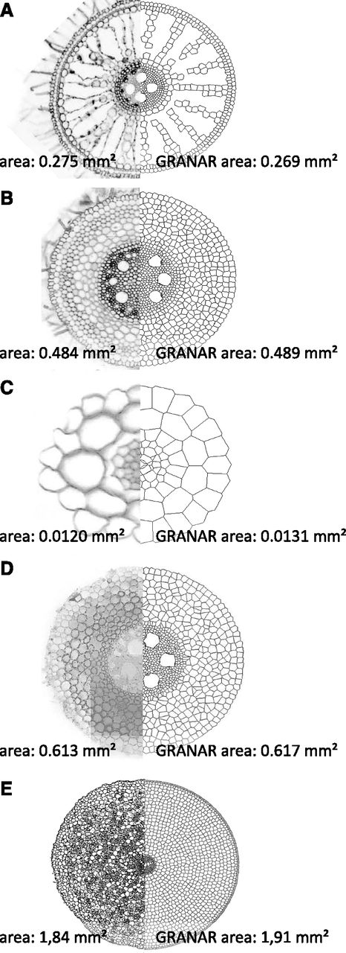
DIVERSITY OF ROOT ANATOMIES WITH GRANAR
- Modelling Root Hydraulic Anatomies -
17

Slide 18
COUPLING GRANAR AND MECHA TO ESTIMATE Kr
https://doi.org/10.1104/pp.19.00617
- Modelling Root Hydraulic Anatomies -
Notes:
Figure 2. Comparison of GRANAR- and CellSeT-based methods used to estimate single-root scale hydraulic properties. The input parameters of GRANAR in the figure were gathered with ImageJ. The radial hydraulic conductivity (kr) values were calculated using the MECHA model assuming an endodermal Casparian strip as the only apoplastic barrier and uniform cell-scale hydraulic properties. The time (indicated as either person or computational using associated graphics) required for each procedure is detailed next to each arrow.
Unless provided in the caption above, the following copyright applies to the content of this slide: © 2020 American Society of Plant Biologists. All Rights Reserved.© The Author(s) 2020. Published by Oxford University Press on behalf of American Society of Plant Biologists. This is an Open Access article distributed under the terms of the Creative Commons Attribution License (https://creativecommons.org/licenses/by/4.0/), which permits unrestricted reuse, distribution, and reproduction in any medium, provided the original work is properly cited.

Slide 19
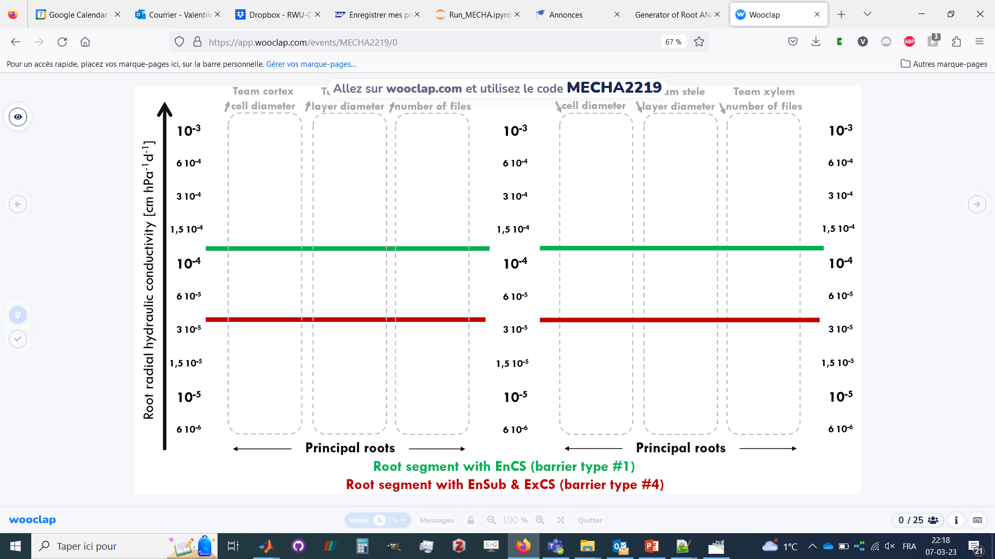
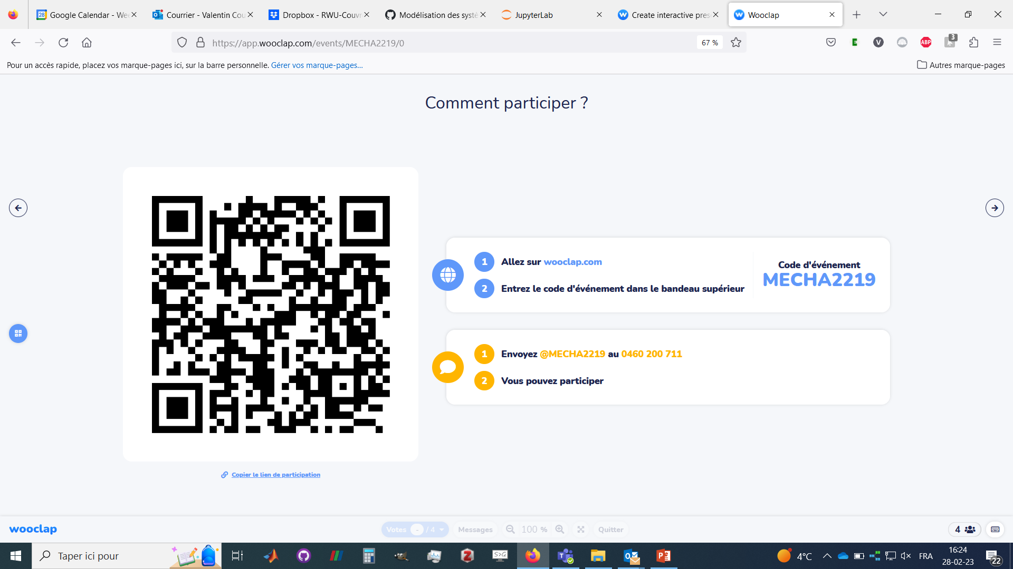
Add updates radial conductivities in your team’s column !
- Modelling Root Hydraulic Anatomies -
19

Slide 20
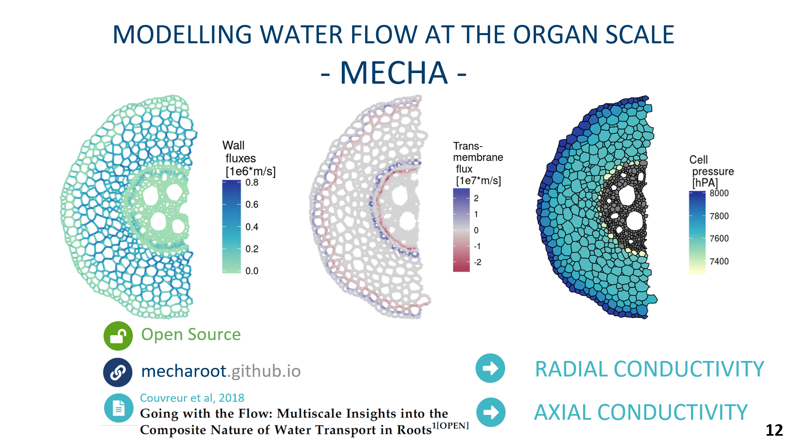
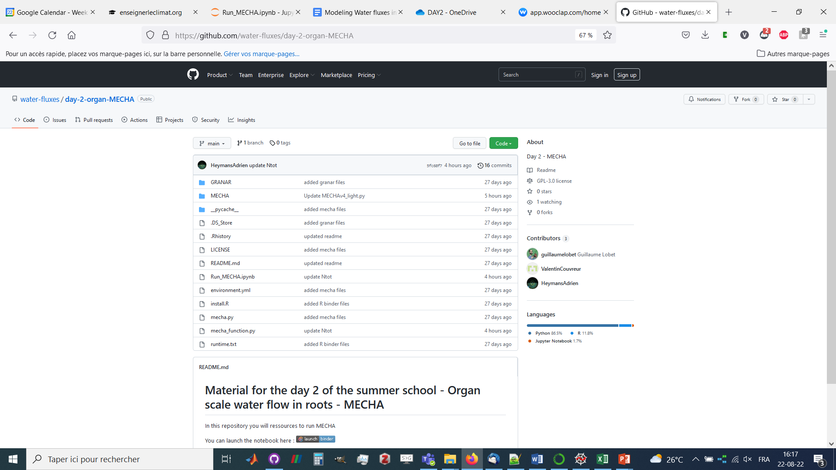
https://github.com/water-fluxes/day-2-organ-MECHA
Run MECHA via Binder
- Modelling Root Hydraulic Anatomies -
20

Slide 21
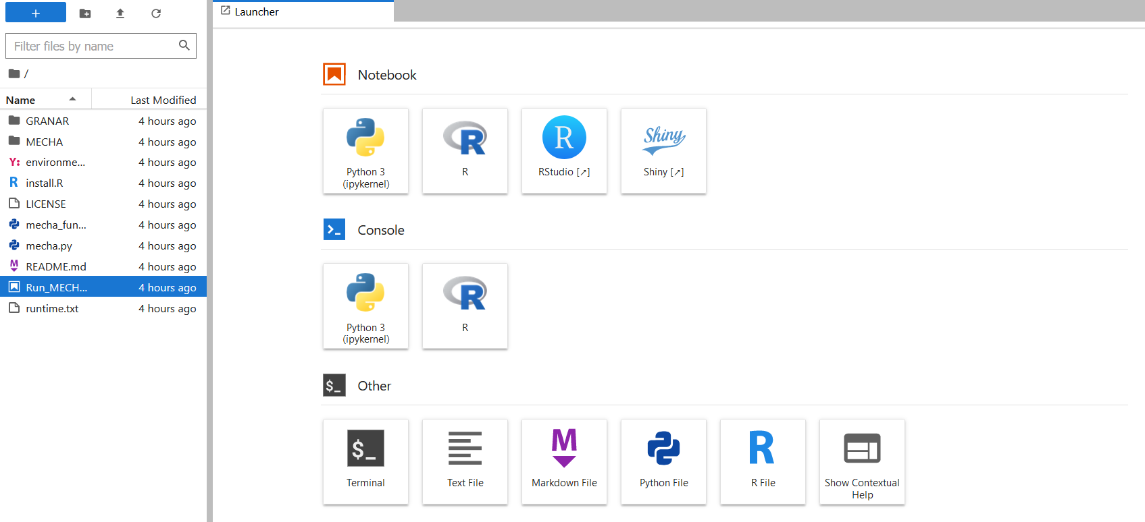
Once on Binder… let’s open the Jupyter Notebook!
Double click on Run_MECHA.ipybn
- Modelling Root Hydraulic Anatomies -
21

Slide 22
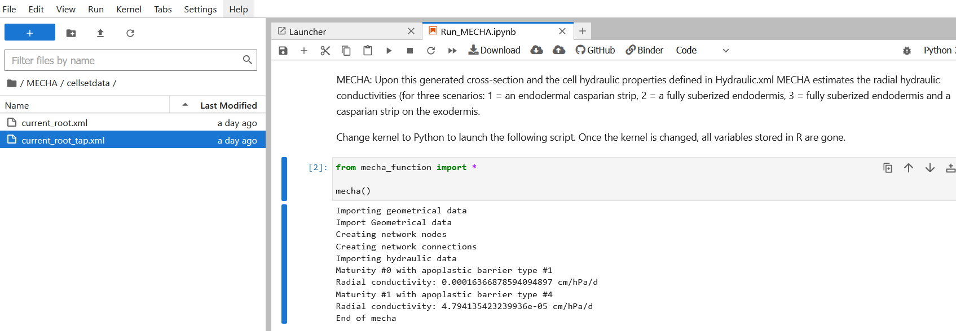
Once on Binder/Jupyter Notebook… let’s run MECHA!
2. Click on play
1. Click on a cell
3. k_{r} for root with Casp
4. k_{r} for suberised root
- Modelling Root Hydraulic Anatomies -
22

Slide 23
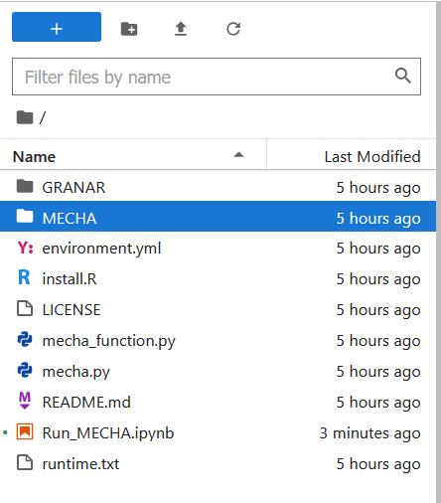
Once on Binder… let’s update the root anatomy!
Double click on folders MECHA/ then cellsetdata/
- Modelling Root Hydraulic Anatomies -
23

Slide 24
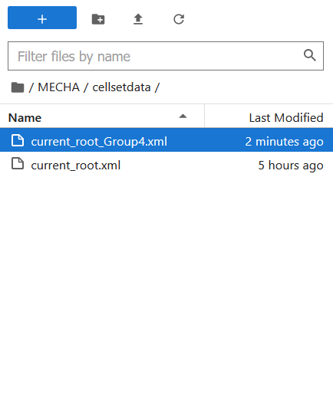
Once on Binder… let’s update the root anatomy!
Drag and drop your root anatomy from GRANAR
Think of adjusting the file name !
- Modelling Root Hydraulic Anatomies -
24

Slide 25
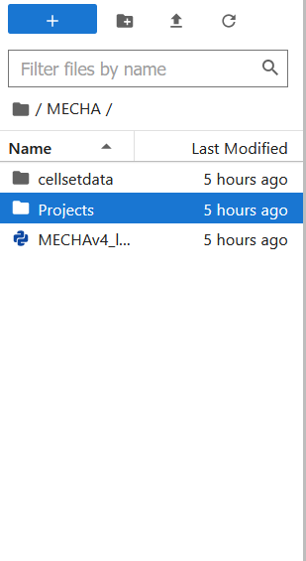
Once on Binder… let’s update the root anatomy!
Go to the folder MECHA/Projects/granar/in/
- Modelling Root Hydraulic Anatomies -
25

Slide 26
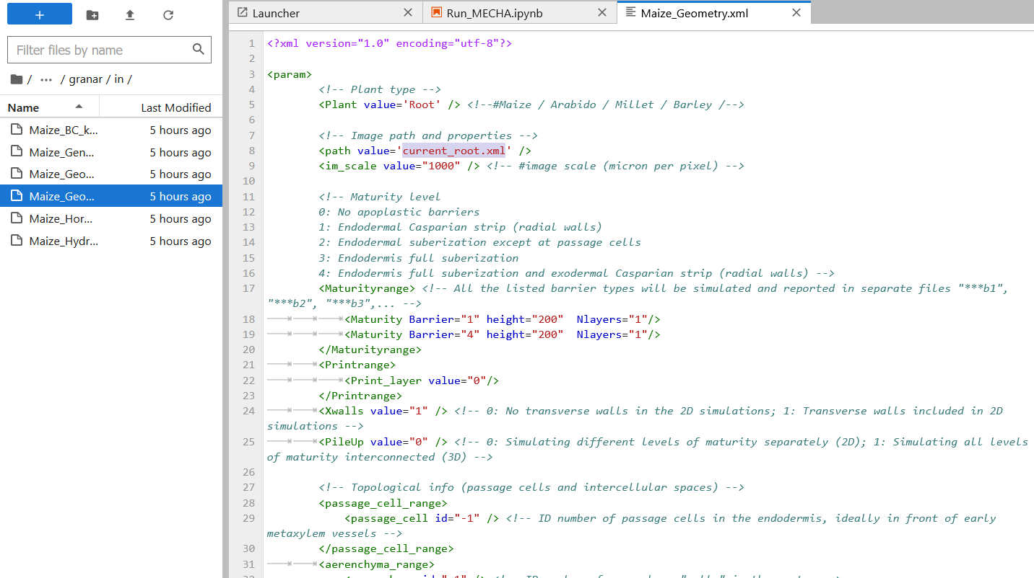
Once on Binder… let’s update the root anatomy!
3. Update the name of folder in which the new outputs will be stored
2. Update the name of the dragged GRANAR output, so it corresponds to your new root anatomy file name (e.g. ‘Principal_root_largeStele.xml’)
1. Open the file ‘Maize_geometry_aer.xml’
4. In Run_MECHA.ipynb, run the cell « from mecha_function … » and check new kr values
- Modelling Root Hydraulic Anatomies -
26

Slide 27
Devoir anatomie - architecture
https://github.com/LBRAI2219-2023/ressources
Exercice individuel
Le but du devoir est de combiner les analyses des modèles anatomiques (GRANAR, MECHA) et architecturaux (MARSHAL).
En particulier, vous devez :
- générer une anatomie avec GRANAR (Shiny app) - utiliser cette anatomie pour estimer des parameters hydrauliques locaux avec MECHA (via Binder) - utiliser ces valeurs de conductivité dans un système racinaire complet à l'aide de MARSHAL
Encore plus précisément, vous devez répondre aux questions suivantes (analyse de sensibilité)
- quel est l'effet de l'anatomie sur Kr - quel est l'effet de l'anatomie des racinaires primaires sur Krs - quel est l'effet de l'anatomie des racinaires latérales sur Krs
Vous devez choisir un des deux types architecturaux fournis par défaut dans la Shiny app de MARSHAL (simplified or not)
Les anatomies de base des racines principales et latérales doivent ressembler aux images ci-dessus.
Pour l’analyse de sensibilité, modifiez UN SEUL paramètre anatomique au choix (de +50% à -50%).
Le répertoire contient un RMD permettant de faire tourner Marshal et un permettant de faire tourner GRANAR.
Vous devez nous fournir un graphique qui permette de répondre à chacune des questions
- Modelling Root Hydraulic Anatomies -
27

Slide 28
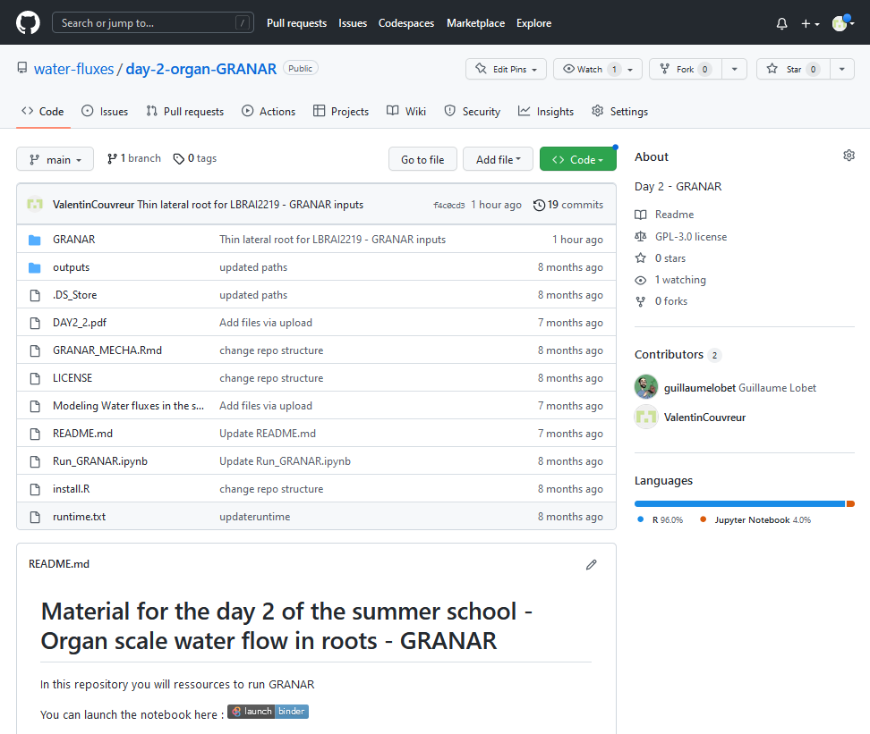
SIMULATING ROOT ANATOMIES
- GRANAR -
https://github.com/water-fluxes/day-2-organ-GRANAR
Run GRANAR via Binder
- Modelling Root Hydraulic Anatomies -
28

Slide 29
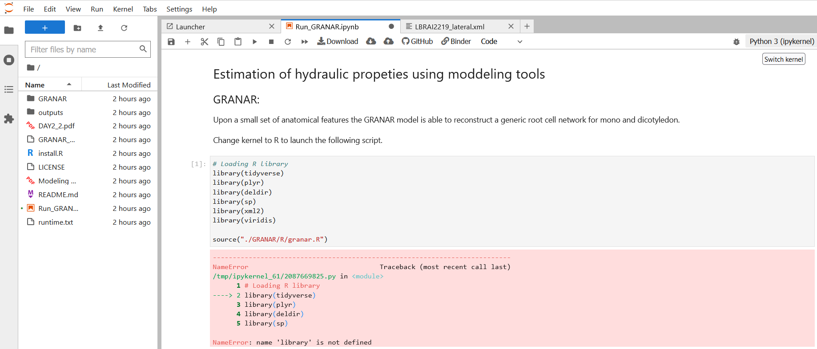
RUNNING GRANAR
3. Click play
1. Change kernel into R
2. Click on
Run_GRANAR*
- Modelling Root Hydraulic Anatomies -
Notes:
Figure 2. Comparison of GRANAR- and CellSeT-based methods used to estimate single-root scale hydraulic properties. The input parameters of GRANAR in the figure were gathered with ImageJ. The radial hydraulic conductivity (kr) values were calculated using the MECHA model assuming an endodermal Casparian strip as the only apoplastic barrier and uniform cell-scale hydraulic properties. The time (indicated as either person or computational using associated graphics) required for each procedure is detailed next to each arrow.
Unless provided in the caption above, the following copyright applies to the content of this slide: © 2020 American Society of Plant Biologists. All Rights Reserved.© The Author(s) 2020. Published by Oxford University Press on behalf of American Society of Plant Biologists. This is an Open Access article distributed under the terms of the Creative Commons Attribution License (https://creativecommons.org/licenses/by/4.0/), which permits unrestricted reuse, distribution, and reproduction in any medium, provided the original work is properly cited.

Slide 30
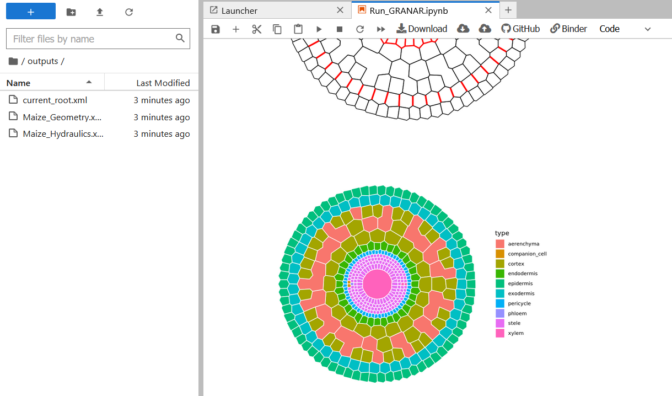
COUPLING GRANAR AND MECHA TO ESTIMATE Kr
1. New root anatomy in output folder
- Modelling Root Hydraulic Anatomies -
Notes:
Figure 2. Comparison of GRANAR- and CellSeT-based methods used to estimate single-root scale hydraulic properties. The input parameters of GRANAR in the figure were gathered with ImageJ. The radial hydraulic conductivity (kr) values were calculated using the MECHA model assuming an endodermal Casparian strip as the only apoplastic barrier and uniform cell-scale hydraulic properties. The time (indicated as either person or computational using associated graphics) required for each procedure is detailed next to each arrow.
Unless provided in the caption above, the following copyright applies to the content of this slide: © 2020 American Society of Plant Biologists. All Rights Reserved.© The Author(s) 2020. Published by Oxford University Press on behalf of American Society of Plant Biologists. This is an Open Access article distributed under the terms of the Creative Commons Attribution License (https://creativecommons.org/licenses/by/4.0/), which permits unrestricted reuse, distribution, and reproduction in any medium, provided the original work is properly cited.

Slide 31
Inputs MARSHAL
Output MECHA kr type 1
Kr principal root (cm/hPa/d)
Output MECHA kr type 4
Output MARSHAL
0 9
20 50
Krs (cm³/hPa/d)
Age (d)
Output MECHA kr type 1
Kr lateral root (cm/hPa/d)
Output MECHA kr type 4
0 9
20 50
Age (d)

Slide 32
Analyse de sensib. MECHA
Kr principal root (cm/hPa/d)
Variable explicative (ex: diam stele)
Kr lateral root (cm/hPa/d)
Variable explicative (ex: diam stele)

Slide 33
Analyse de sensib. MARSHAL
Sensibilité variations anatomiques racines latérales
Krs (cm³/hPa/d)
Sensibilité variations anatomiques racines principales
Variable explicative (ex: diam stele)

Slide 34
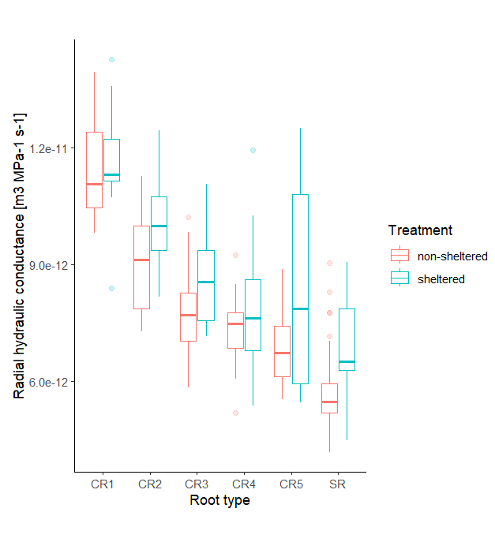
If roots from higher crown numbers show greater hydraulic conductance, what does this suggest about their internal structure?

Slide 35
